Slide 1

MATRIX MULTIPLICATION
Presented by: Chetna Dua (205124026)
Subject Name: Design and Analysis of Algorithms
Instructor name: Ms. Eshwari

Slide 2
Strassen’s Algorithm for Matrix Multiplication– Divide and Conquer Approach
SQUARE_MATRIX_MULTIPLICATION (A,B) //square matrix of order N
N = A.rows()
C be a new n * n matrix
for i = 1 to N
for j = 1 to N
c_{ij} = 0
for k = 1 to N
c_{ij}+= a_{ik} + b_{kj}
Return
Complexity: O(N^3)

Slide 3
Strassen’s Algorithm for Matrix Multiplication– Divide and Conquer Approach
SQUARE_MATRIX_MULTIPLICATION_RECURSIVE (A,B) //Here N is in Power of 2
N = A.rows
Let C be a new N * N matrix //So that n/2 is always integer
If N==1
return c11=a11*b11
Else partition A, B and C
C11 = SQUARE_MATRIX_MULTIPLICATION_RECURSIVE(A11,B11)+SQUARE_MATRIX_MULTIPLICATION_RECURSIVE(A12,B21)
C12 = SQUARE_MATRIX_MULTIPLICATION_RECURSIVE(A11,B12)+SQUARE_MATRIX_MULTIPLICATION_RECURSIVE(A12,B22)
C21 = SQUARE_MATRIX_MULTIPLICATION_RECURSIVE(A21,B11)+SQUARE_MATRIX_MULTIPLICATION_RECURSIVE(A22,B21)
C22 = SQUARE_MATRIX_MULTIPLICATION_RECURSIVE(A21,B12)+SQUARE_MATRIX_MULTIPLICATION_RECURSIVE(A22,B22)
Returns C
Complexity: O(N^3)
8 T ( N/2) + O(N^2) ~ 8 recursive calls

Slide 4
Strassen’s Algorithm for Matrix Multiplication– Divide and Conquer Approach
SQUARE_MATRIX_MULTIPLICATION_RECURSIVE (A,B) //Here N is in Power of 2
N = A.rows
Let C be a new N * N matrix //So that n/2 is always integer
If N==1
return c11=a11*b11
Else partition A, B and C
C11 = SQUARE_MATRIX_MULTIPLICATION_RECURSIVE(A11,B11)+SQUARE_MATRIX_MULTIPLICATION_RECURSIVE(A12,B21)
C12 = SQUARE_MATRIX_MULTIPLICATION_RECURSIVE(A11,B12)+SQUARE_MATRIX_MULTIPLICATION_RECURSIVE(A12,B22)
C21 = SQUARE_MATRIX_MULTIPLICATION_RECURSIVE(A21,B11)+SQUARE_MATRIX_MULTIPLICATION_RECURSIVE(A22,B21)
C22 = SQUARE_MATRIX_MULTIPLICATION_RECURSIVE(A21,B12)+SQUARE_MATRIX_MULTIPLICATION_RECURSIVE(A22,B22)
Returns C
Complexity: O(N^3)
8 T ( N/2) + O(N^2) ~ 8 recursive calls
8 recursive multiplications of size N/2 * N/2 matrices!

Slide 5
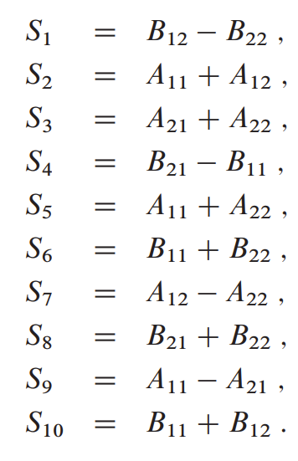
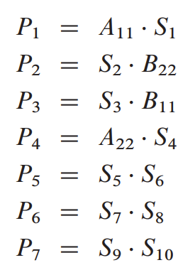




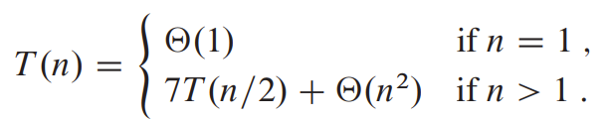
Strassen’s Algorithm - Motivation
Instead of performing 8 recursive multiplications on matrices of order n/2, Strassen’s Algorithm reduces it to seven recursive multiplications!
Cost of eliminating one multiplication is, addition of constant number of n/2 order matrices
Steps :
Divide A ,B , C into n/2 order matrices
Create 10 matrices S1 to S10 (constant additions, order n/2)
Computing P1 to P7 (actual recursive Products order n/2) using S1 to S10.
Computing C11, C12, C21, C22 from Pi matrices (constant number of additions)
Formulas (for reference)

Slide 6
Strassen’s Algorithm - Motivation
Instead of performing 8 recursive multiplications on matrices of order n/2, Strassen’s Algorithm reduces it to seven recursive multiplications!
Cost of eliminating one multiplication is, addition of constant number of n/2 order matrices
Steps :
Divide A ,B , C into n/2 order matrices
Create 10 matrices S1 to S10 (constant additions, order n/2)
Computing P1 to P7 (actual recursive Products order n/2) using S1 to S10.
Computing C11, C12, C21, C22 from Pi matrices (constant number of additions)
Formulas (for reference)
This is recursive parta ~ 7 T (N/2)

Slide 7
Strassen’s Algorithm - Motivation
Instead of performing 8 recursive multiplications on matrices of order n/2, Strassen’s Algorithm reduces it to seven recursive multiplications!
Cost of eliminating one multiplication is, addition of constant number of n/2 order matrices
Algorithm :
Divide A ,B , C into n/2 order matrices
Create 10 matrices S1 to S10 (constant additions, order n/2)
Computing P1 to P7 (actual recursive Products order n/2) using S1 to S10.
Computing C11, C12, C21, C22 from Pi matrices (constant number of additions)
Formulas (for reference)
Cost of Each Step: 10 * N^2 = O(N^2)
4 * O(N^2) = O(N^2)

Slide 8
WHAT WHEN MORE THAN 2 MATRICES TO MULTIPLY?

Slide 9
WHAT WHEN MORE THAN 2 MATRICES TO MULTIPLY?
CONCEPT : - MATRIX CHAIN MULTIPLICATION

Slide 10
MATRIX CHAIN MULTIPLICATION – DYNAMIC PROGRAMMING
Problem: Parenthesize the matrix chain to
Goal : Minimize the number of Scalar multiplication

Slide 11
MATRIX CHAIN MULTIPLICATION – DYNAMIC PROGRAMMING
Problem: Parenthesize the matrix chain to
Goal : Minimize the number of Scalar multiplication
Parenthesizing Chain
Given matrix chain of length 4
A1,A2,A3,A4,
Rule: split chain with parenthesis until more than 2 matrices
(A1 A2 A3 A4)
(A1 (A2 A3 A4) )
(A1 (A2( A3 A4 ) ) )
Parenthesizing, 5 ways
(A1 (A2 (A3 A4))) -1
(A1 ((A2 A3) A4)) -2
(A1 A2) (A3 A4) -3
((A1 (A2 A3)) A4) -4
(((A1 A2) A3) A4) -5
Out of 5 chains! Which one is best?

Slide 12
MATRIX CHAIN MULTIPLICATION – DYNAMIC PROGRAMMING
Problem: Parenthesize the matrix chain to
Goal : Minimize the number of Scalar multiplication
Parenthesizing Chain
Given matrix chain of length 4
A1,A2,A3,A4,
Rule: split chain with parenthesis until more than 1 matrix
(A1 A2 A3 A4)
(A1 (A2 A3 A4) )
(A1 (A2( A3 A4 ) ) )
Parenthesizing, 5 ways
(A1 (A2 (A3 A4))) -1
(A1 ((A2 A3) A4)) -2
(A1 A2) (A3 A4) -3
((A1 (A2 A3)) A4) -4
(((A1 A2) A3) A4) -5
Out of 5 chains! Which one is best? - The one requiring Minimum number of Multiplications

Slide 13
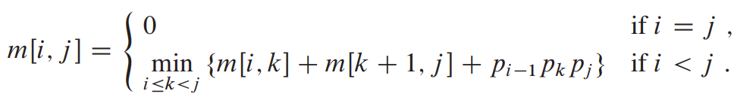
MATRIX CHAIN MULTIPLICATION – DYNAMIC PROGRAMMING
-Number of Multiplications
One matrix
More than 1 matrix
-For each value of i<=k<=j,
-k = split index

Slide 14
MATRIX CHAIN MULTIPLICATION – DYNAMIC PROGRAMMING
-Number of Multiplications
One matrix
More than 1 matrix
-For each value of i<=k<=j, k = split index
Optimal Substructure
Minimal Number of Multiplications
Value of k = minimal multiplications

Slide 15
MATRIX CHAIN MULTIPLICATION – DYNAMIC PROGRAMMING
-Number of Multiplications
One matrix
More than 1 matrix
-For each value of i<=k<=j, k = split index

Slide 16
MATRIX CHAIN MULTIPLICATION – DYNAMIC PROGRAMMING
-Number of Multiplications
One matrix
More than 1 matrix
-For each value of i<=k<=j,
-k = split index
Number of multiplications to calculate left split (optimized)

Slide 17
MATRIX CHAIN MULTIPLICATION – DYNAMIC PROGRAMMING
-Number of Multiplications
One matrix
More than 1 matrix
-For each value of i<=k<=j,
-k = split index
right split

Slide 18
MATRIX CHAIN MULTIPLICATION – DYNAMIC PROGRAMMING
-Number of Multiplications
One matrix
More than 1 matrix
-For each value of i<=k<=j,
-k = split index
Multiplying left and right

Slide 19
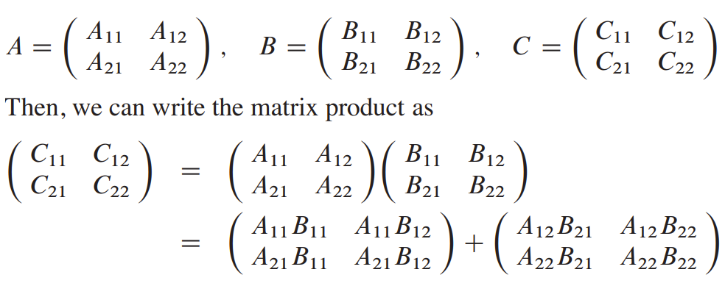
Matrix Multiplication using Multithreading
To multiply two n * n matrices
we perform 8 multiplications of N/2 * N/2
one addition of N²

Slide 20










Matrix Multiplication using Multithreading
Parallelism?

Slide 21
Matrix Multiplication using Multithreading
Parallelism?
Four Threads to compute first half of multiplications (C)

Slide 22
Matrix Multiplication using Multithreading
Parallelism?
Four Threads to compute second half of multiplications (T)

Slide 23
Matrix Multiplication using Multithreading
Parallelism?
Addition of C with T in O(N^2)

Slide 24
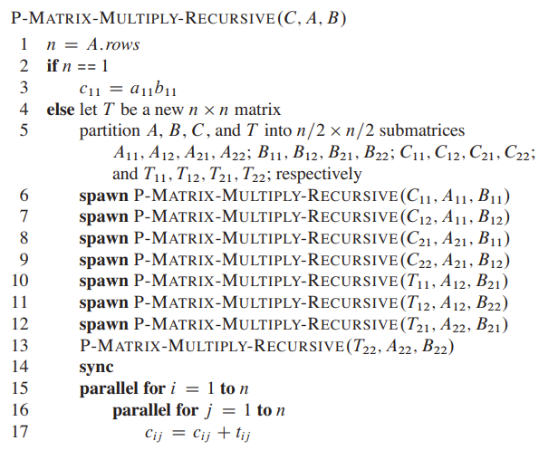
Matrix Multiplication using Multithreading

Slide 25
Matrix Multiplication using Multithreading
Lets go for Code Execution!

Slide 26
THANK YOU

